Slide 1
Presented by:
G. Srinath 14H51A0519
Sindhuja Sharma 14H51A0521
Himanshu Joshi 14H51A0523
Nishanth Reddy 14H51A0524
Guided by:
Mrs. P. Sruthi

Slide 2
Outline
Objective
Motivation
Introduction
Block Diagram
Hardware & Software
Application
Advantages
Summary
Work Pictures

Slide 3


Slide 4
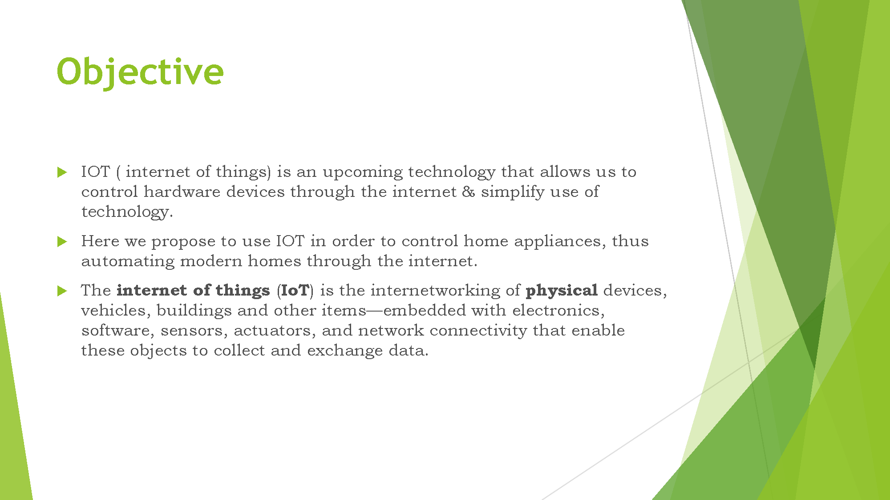

Slide 5


Slide 6
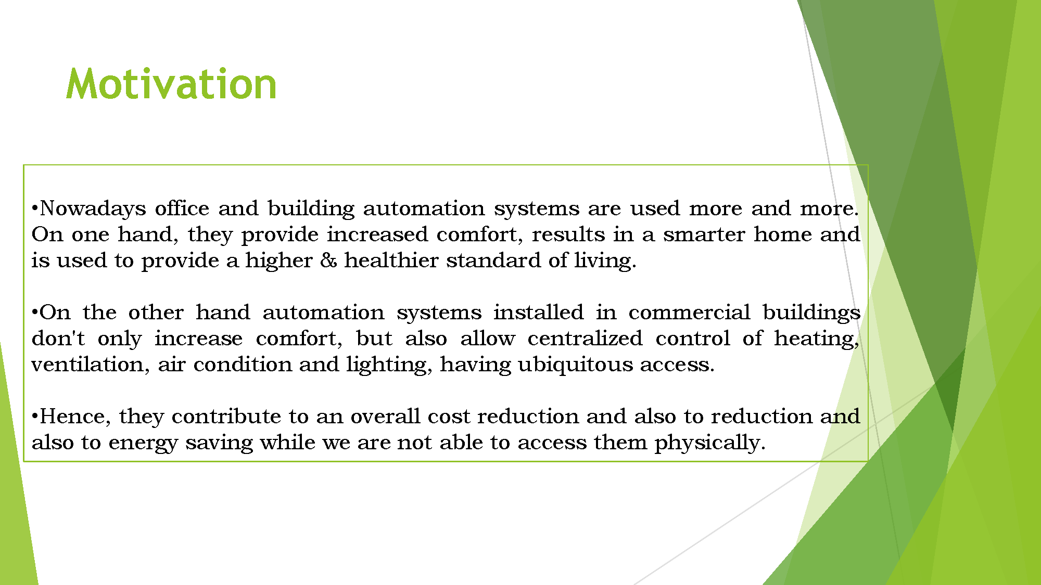

Slide 7


Slide 8
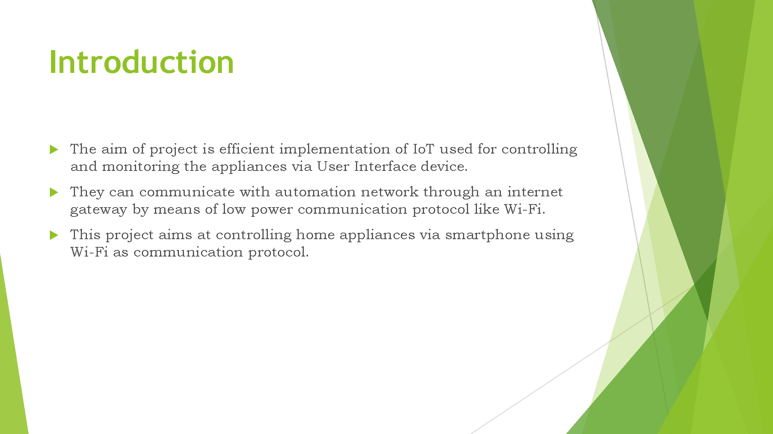

Slide 9
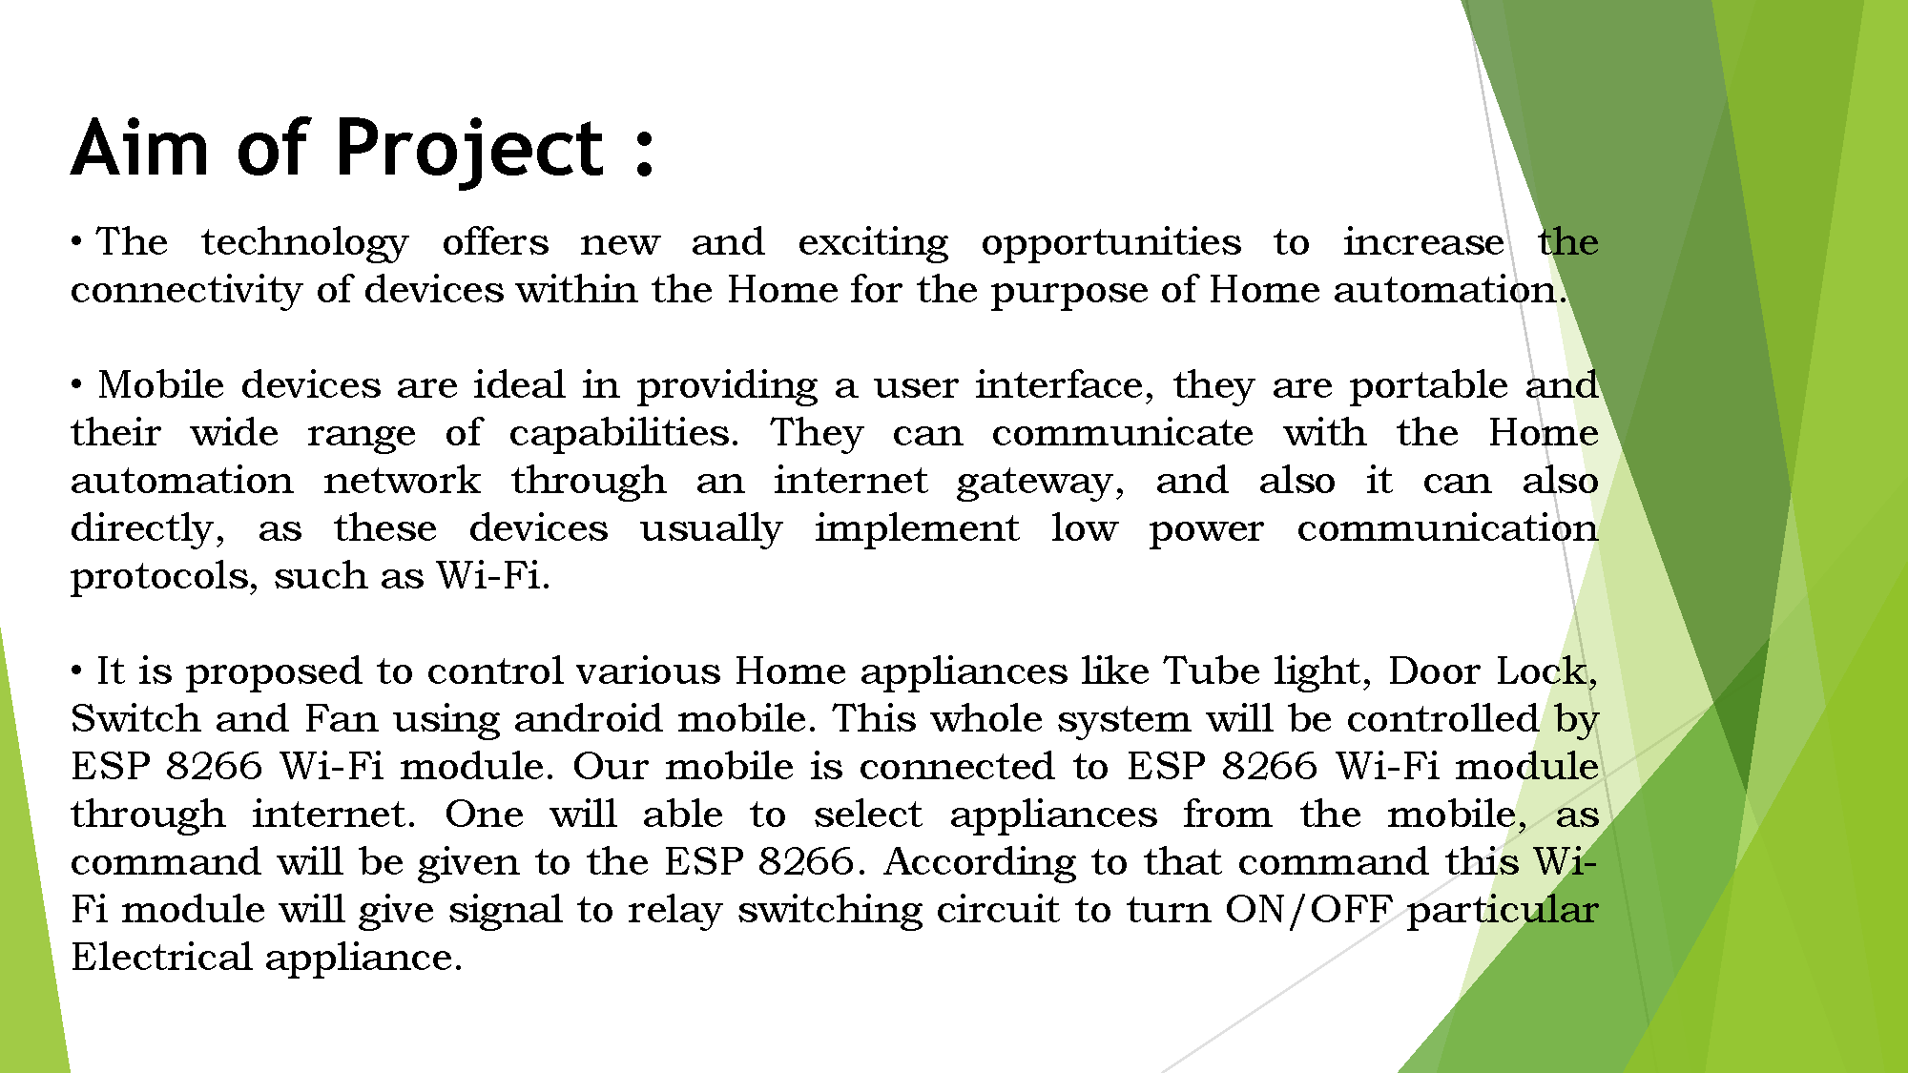

Slide 10
Block Diagram

Slide 11
Block Diagram
LCD
TEMPERATURE SENSOR
SENSOR
ARDUINO BOARD
ULTRASONIC SENSOR
ESP
MOBILE APPLICATION
CLOUD

Slide 12


Slide 13
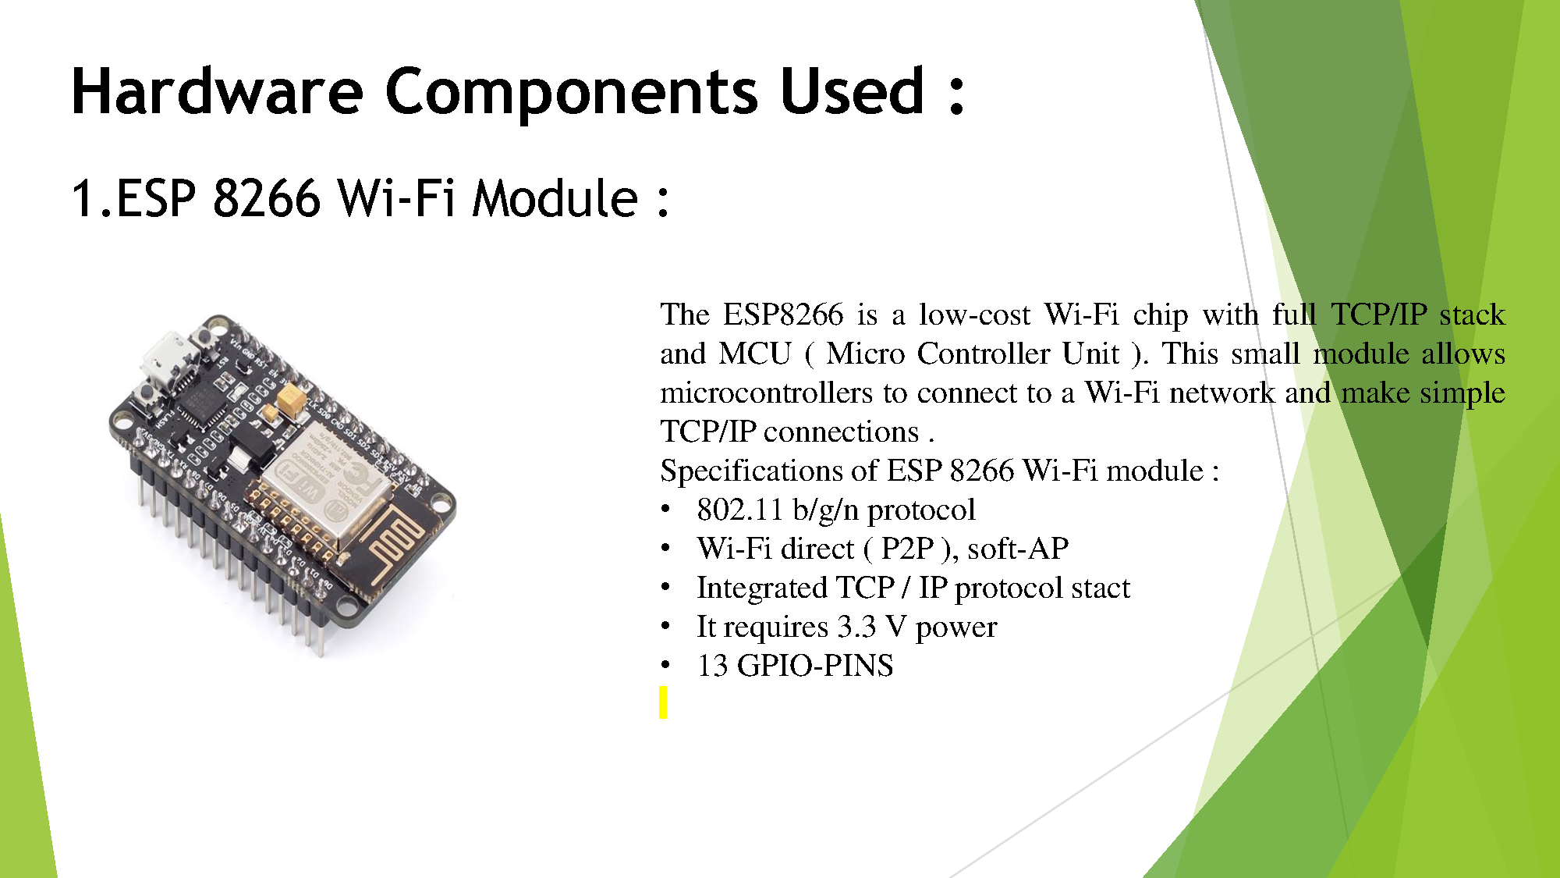

Slide 14
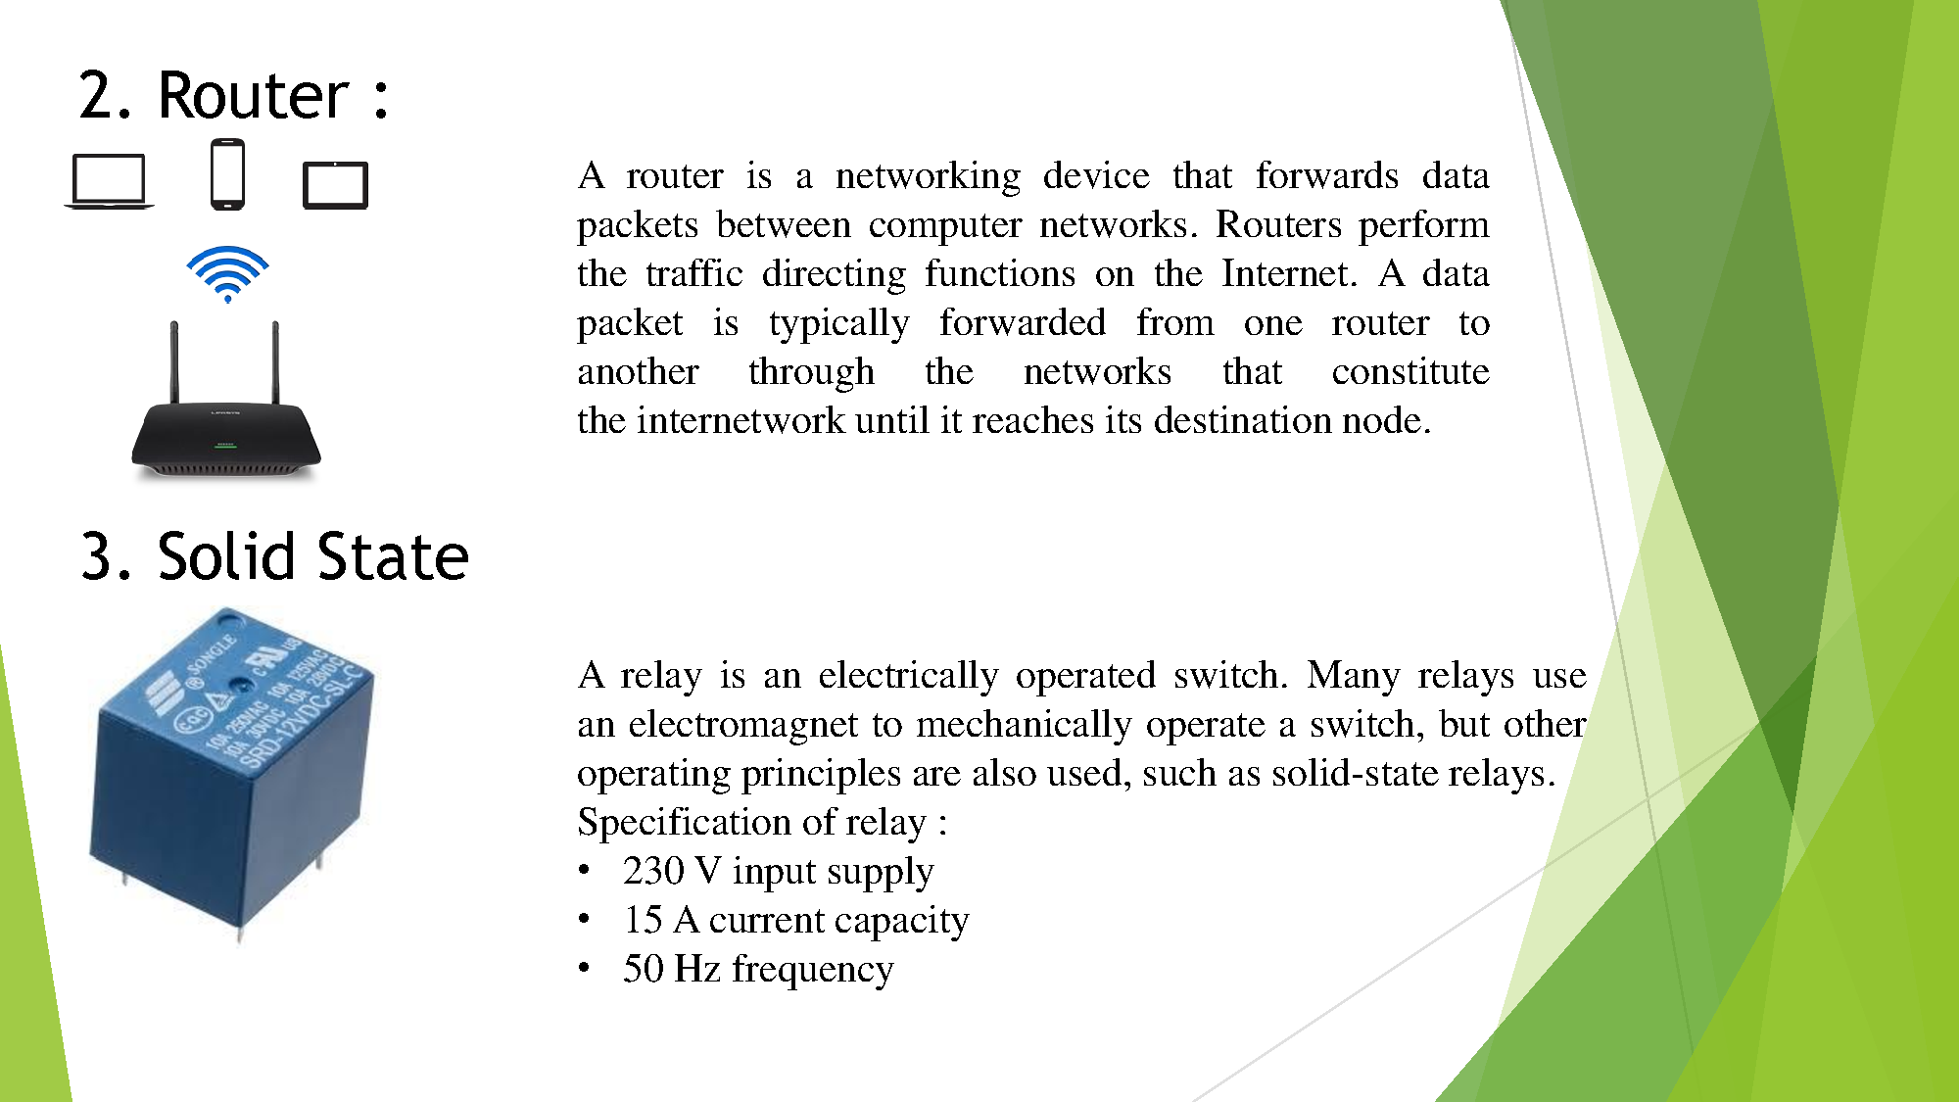

Slide 15
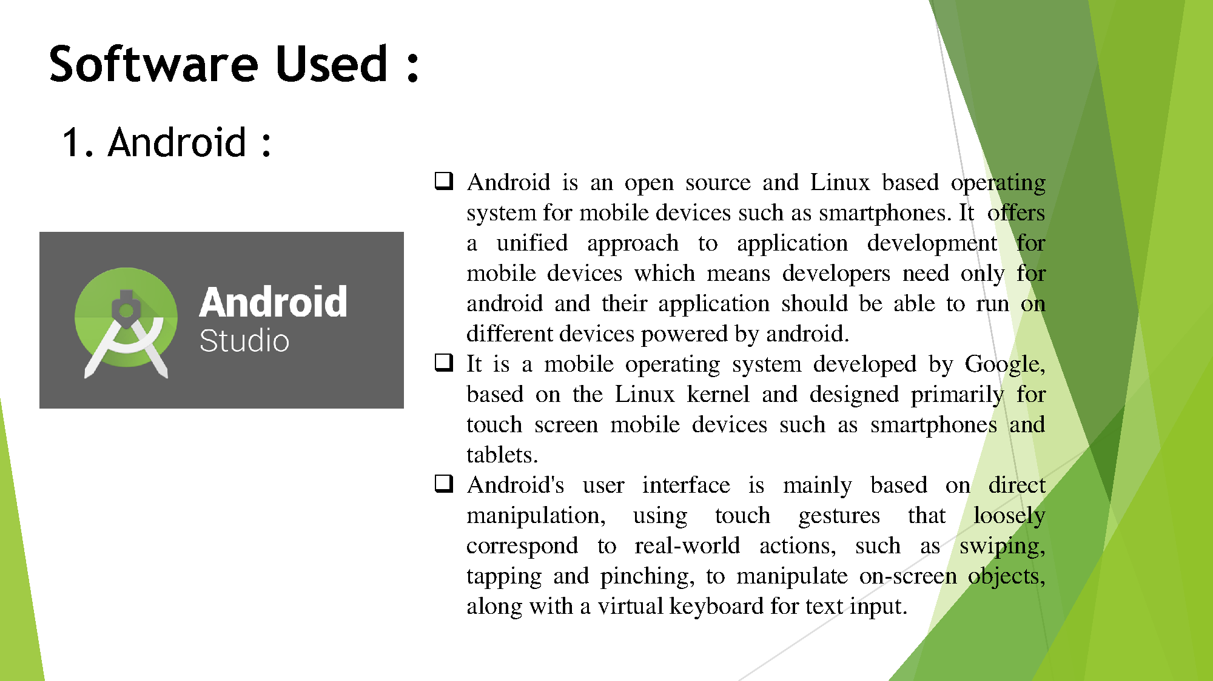

Slide 16
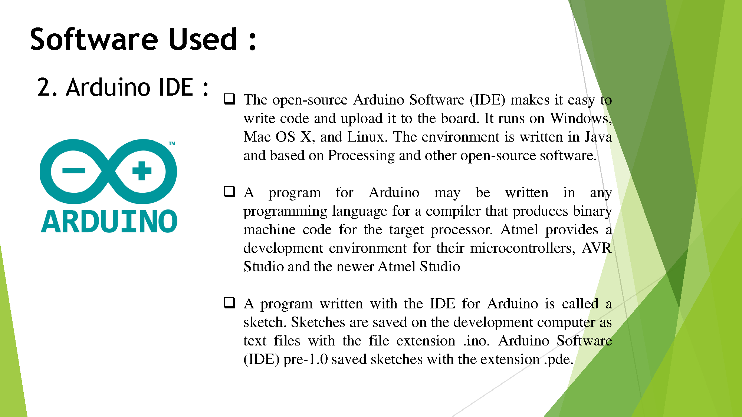

Slide 17
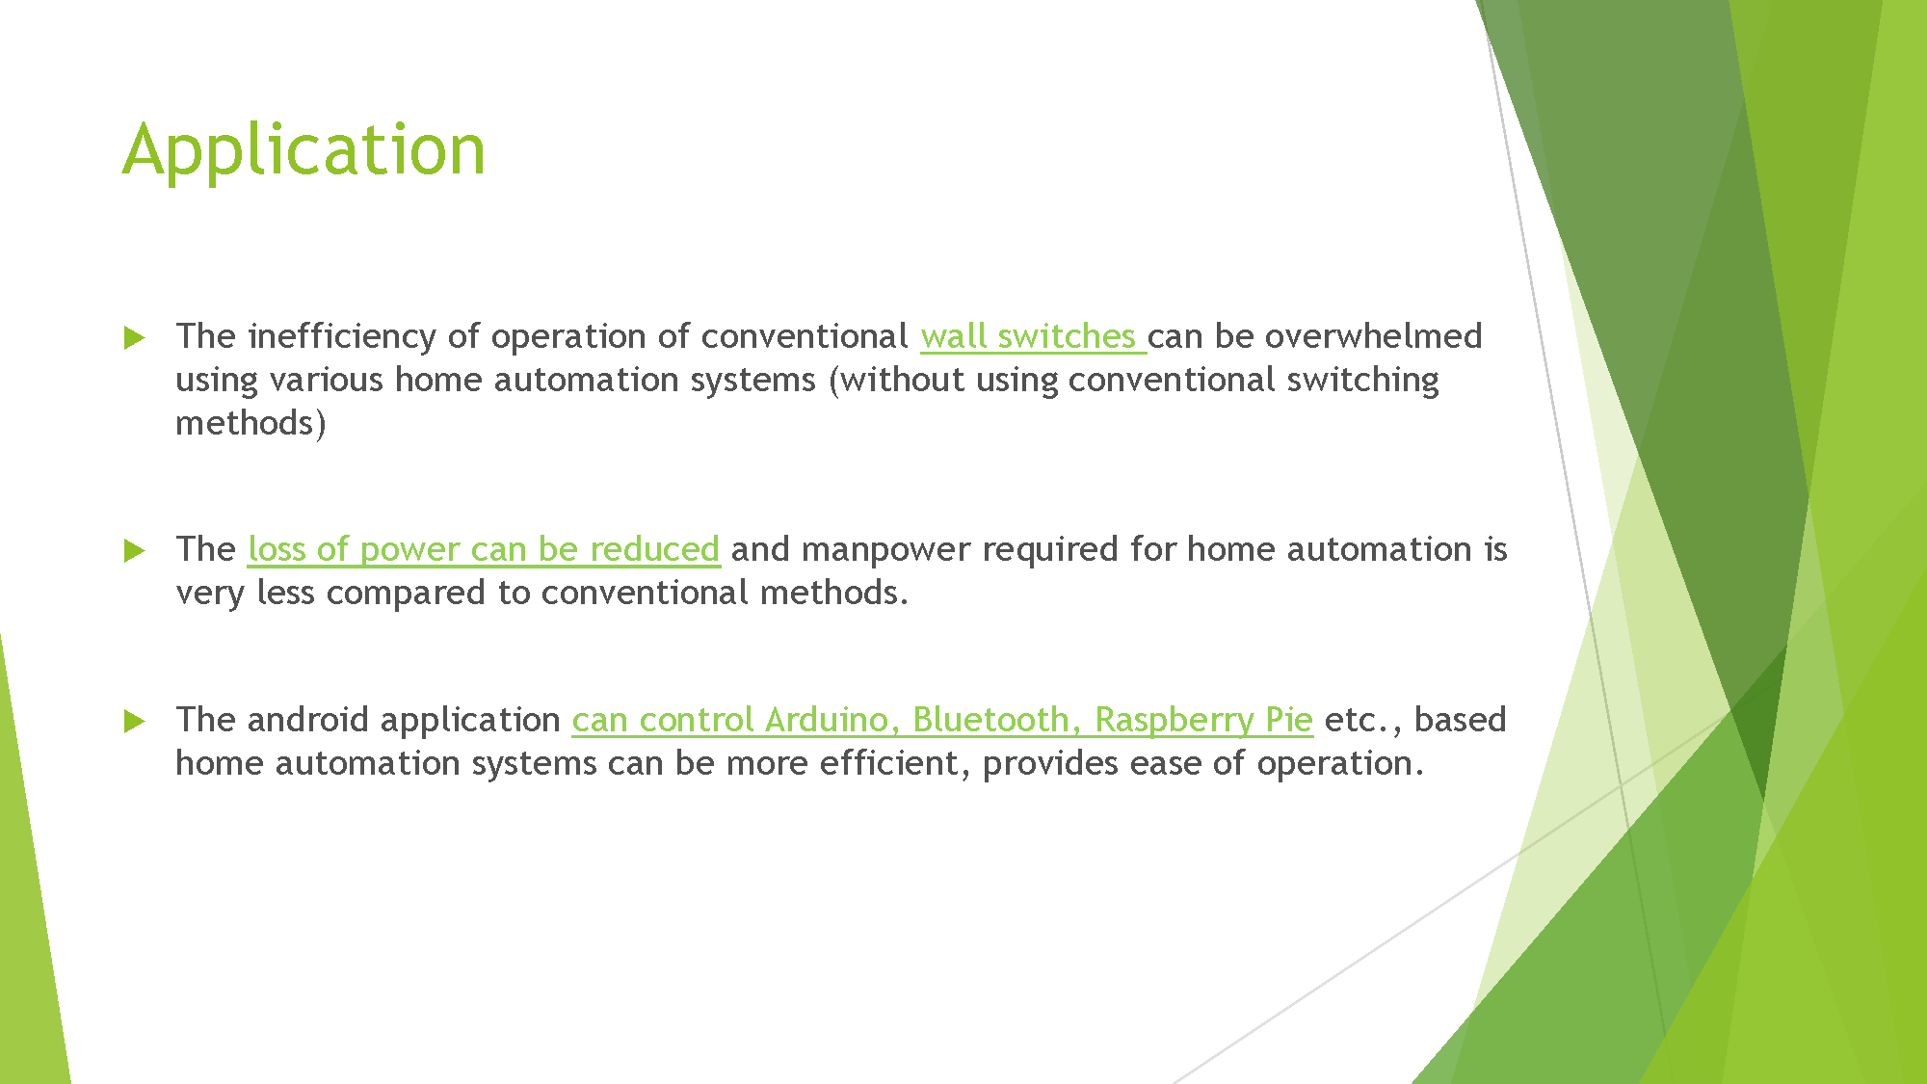

Slide 18
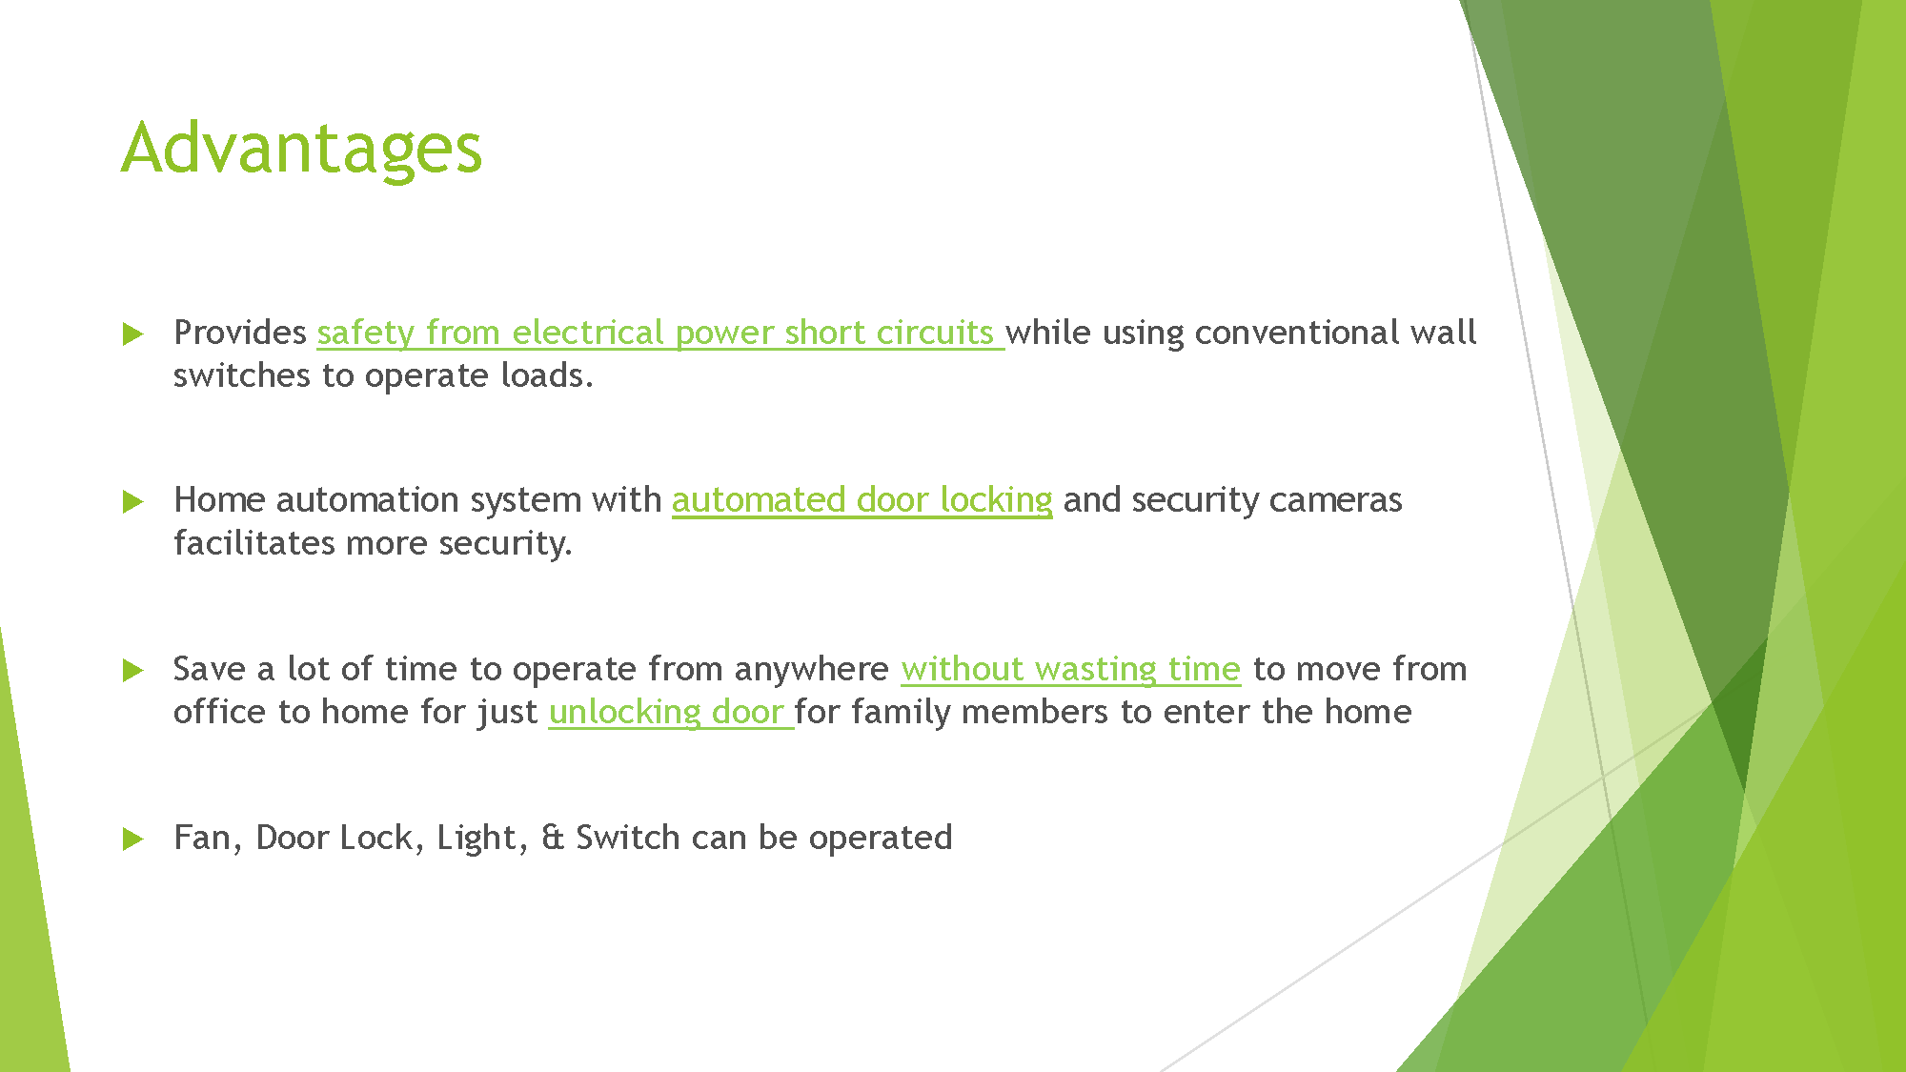

Slide 19
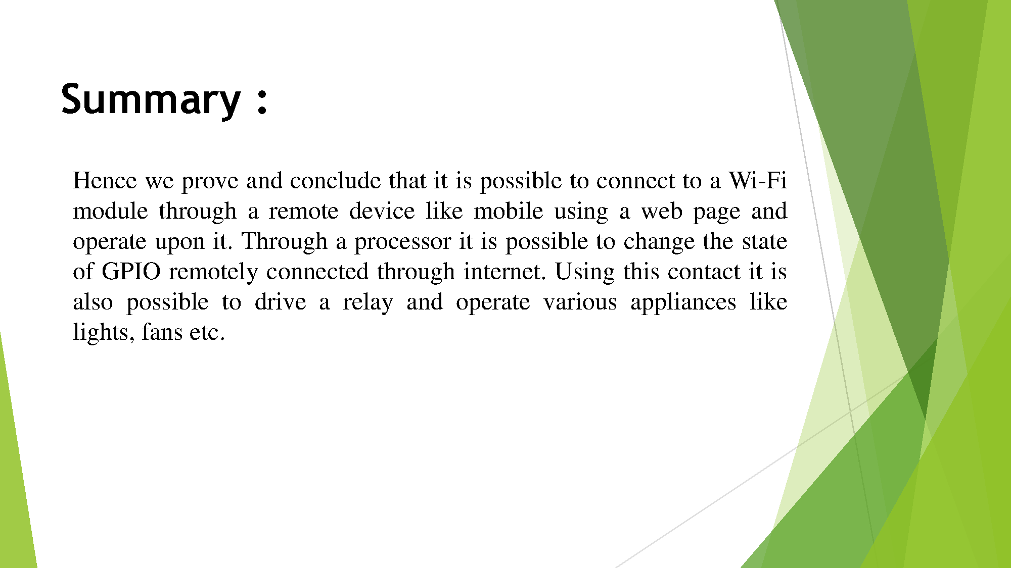

Slide 20
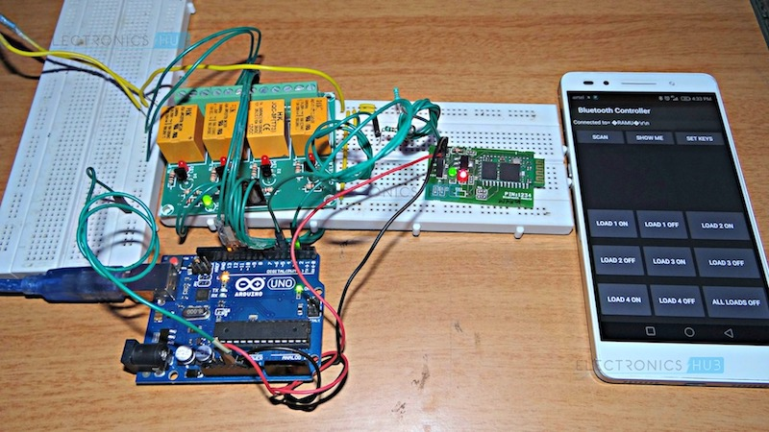
Work Picture

Slide 21


